Slide 1
CPSC 323 Compilers and Languages
Miss Susmitha Padda
spadda@fullerton.edu
Inputs from Rong Jin and Doina Bein

Slide 2
Structure of Compiler
Lexical Analysis
Syntax Analysis (Parsing)
Semantic Analysis
Intermediate Code Generation
Code Optimization
Target Code Generation

Slide 3
Structure of Compiler
Lexical Analysis
x = a + b * c;
Syntax Analysis
Semantic Analysis
Compiler
Intermediate Code Generation
Code Optimization
Target Code Generation
.
.
mov eax, DWORD PTR[rbp-8]
imul eax, DWORD PTR[rbp-12]
mov edx, eax
mov eax, DWORD PTR[rbp-4]
add eax, edx
mov DWORD PTR[rbp-16], eax
.
.

Slide 4
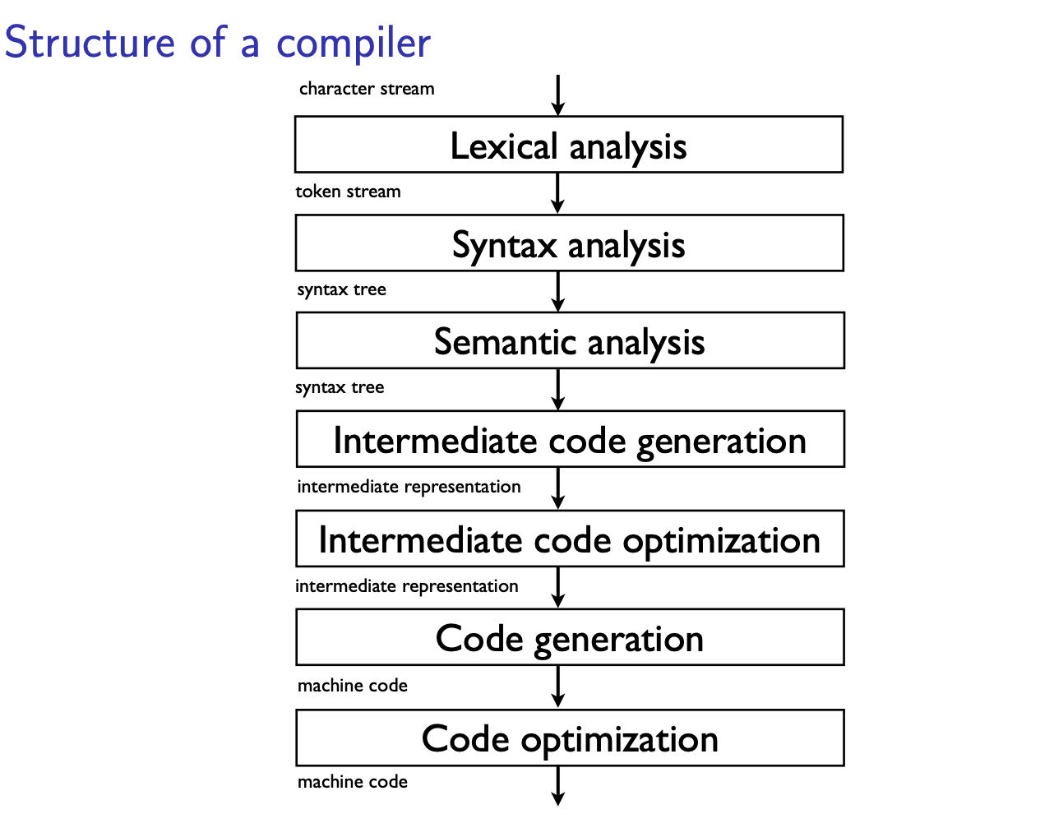

Slide 5
Lexical Analyzer
Lexemes and Tokens
A Lexeme is a string of characters that is a lowest-level syntatic unit in the programming language. These are the "words" and punctuation of the programming language.
A Token is a syntactic category that forms a class of lexemes. These are the "nouns", "verbs", and other parts of speech for the programming language.
In a practical programming language, there are a very large number of lexemes, perhaps even an infinite number. In a practical programming language, there are only a small number of tokens.
A program - Basic task is to scans the source code as a stream of characters and converts it into meaningful lexemes. These lexemes in the form of tokens.

Slide 6
Lexical analyzer which breaks the source code up into meaningful
Units called tokens
Meaningful units may be different from language to language
Ex. C source code: if (x == y) a = b - 5;
tokens:
Keywords: if
Identifiers: x, y, a, b
Constants: 5
Operators: ==, =, -
Punctuations: ;
Parentheses: (, )
Lexical Analysis frequently does other operations as well:
removes excessive white spaces (blank, tab etc.)
overpasses comments
case conversion if needed
It is recognition of a regular language, e.g., via a DFA

Slide 7
Lexical Analyzer
x = a + b * c;
Recognizes tokens using Regexs.
E.g. Regex for identifier:
l(l+d)* | _(l+d)*
l: letter
d: digit
_: underscore
Lexical Analysis
Lexemes | Tokens
x | identifier
= | operator
a | identifier
+ | operator
b | identifier
* | operator
c | identifier
; | symbol

Slide 8
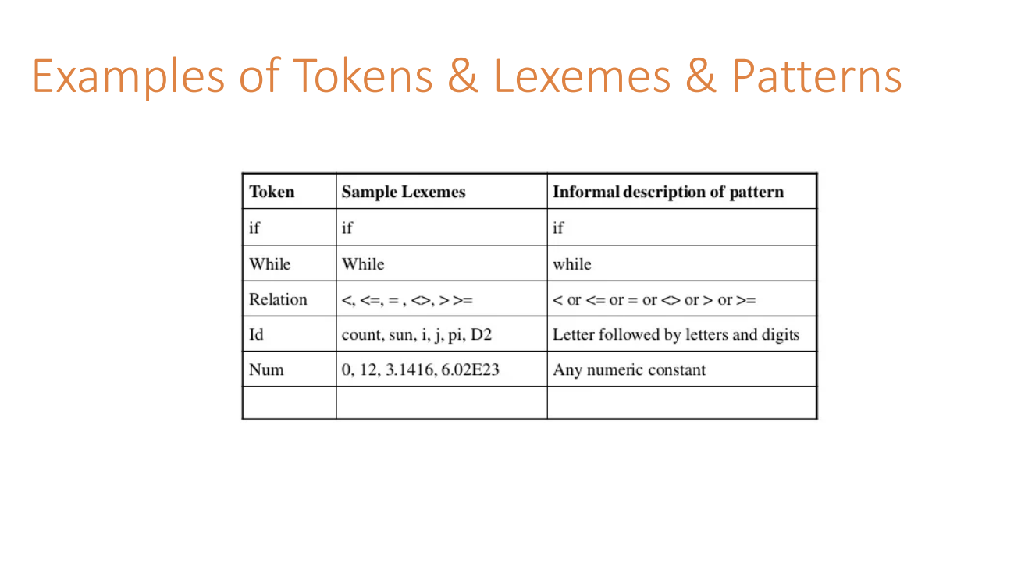
Demo for reference :
https://www.youtube.com/watch?v=VGgIZl5WjH0

Slide 9
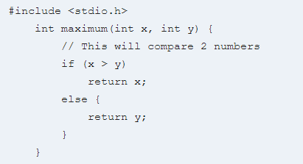
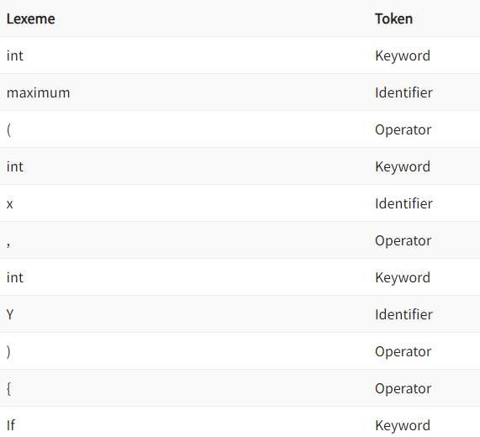
Consider the following code that is fed to Lexical Analyzer (scanner):

Slide 10
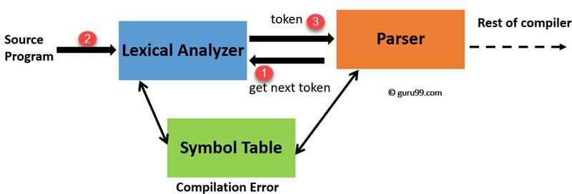
How are tokens recognized?
“Get next token” is a command which is sent from the parser to the lexical analyzer.
On receiving this command, the lexical analyzer scans the input until it finds the next token.
It returns the token to Parser.

Slide 11
SUMMARY
A token is a generic type, as passed to the parser.
A Lexeme is the actual/specific instance of the token.

Slide 12
SPECIFICATION OF TOKENS :
Alphabets σ
Any finite set of symbols {0,1} is a set of binary alphabets σ = {0,1}
σ = {0,1,2,3,4,5,6,7,8,9,A,B,C,D,E,F} is a set of Hexadecimal alphabets
σ = {a-z, A-Z} is a set of English language alphabets.
Strings
Any finite sequence of alphabets (characters) is called a string.
Length of the string is the total number of occurrence of alphabets. e.g., the length of the string ‘tutorialspoint’ is 14
and is denoted by |tutorialspoint| = 14.
A string having no alphabets, i.e., a string of zero length is known as an empty string and is denoted by ε (epsilon)
Example: if σ = {0, 1}, then 10, 1000, 0, 101 and 𝜖 are strings over σ

Slide 13
REGULAR LANGUAGE:
A regular language is considered as a finite set of strings over some finite set of alphabets.
Computer languages are considered as finite sets, and mathematically set operations can be performed on them.
A regular language is a formal language that can be expressed by means of regular expressions by defining a pattern for finite strings of symbols
The grammar defined by regular expressions is known as regular grammar
For lexical analysis, we care about regular languages
The lexical analyzer needs to scan and identify only a finite set of valid tokens that belong to the programming language in hand
Tokens can be described by regular expressions

Slide 14
Syntax Analyzer
S
id = id + id * id ;
Lexemes | Tokens
x | identifier
= | operator
a | identifier
+ | operator
b | identifier
* | operator
c | identifier
; | symbol
id
=
E
;
E
+
T
Syntax Analysis
T
T
*
F
S → id = E;
E → E + T | T
T → T * F | F
F → id
F
F
id
x = a + b * c;
id
id
Parse Tree

Slide 15
Syntax Analyzer
The Syntax analyzer also known as the parser.
The Syntax analyzer depends on the type two or context free grammars.
In order to find out the yield of the parse tree, we will have to traverse it top to bottom left to right.
In short, taking the stream of tokens, the syntax analyzer analyzes them following specific set of production rules and produces the parse tree. If the yield of the parse tree and the providers stream of tokens are the same, then there is no error, otherwise there is some syntax error in the statement.

Slide 16
Questions ?

